Slide 1
"Here's an idea that's gonna help a little or hurt a whole lot – Who needs a drink?" -Ted Lasso
IST 718
Brooke McCurdy, Kelsey Johnson, Lee Scott, MJ Schulz, Sam Hochheimer

Slide 2





Goals
Share results of the whisky analysis conducted this semester.
Identify ways to predict cost and ratings based on other attributes.
Using customer reviews, find preferences for flavors of whisky.
Based on whisky attributes, provide recommendations to consumers.
Forecast trends in whisky imports from UK to US.

Slide 3

What data do we need?
Scotch Whisky Dataset ¹
Attribute scores of 86 malt scotch whiskies
86 rows x 17 columns
2,2k+ Scotch Whisky Reviews ²
Whisky brand, type, price, and reviews
2245 rows x 7 columns
Distillery Coordinates ³
Standardized latitude and longitude of distilleries
109 rows x 3 columns
US Trade and Tariff Data ⁴
Customs value of spirits, liqueurs, and other spiritous beverages imported from UK to USA
413 rows x 21 columns
1. Thatdataanalyst. (2018, March 22). Scotch Whisky Dataset [data set]. Kaggle. https://www.kaggle.com/koki25ando/scotch-whisky-dataset
2. Thatdataanalyst. (2018, June 13). 2,2k+ Scotch Whisky Reviews [data set]. Kaggle. https://www.kaggle.com/koki25ando/22000-scotch-whisky-reviews
3. Whisky.com. (n.d.). Whisky Distilleries [data set]. https://www.whisky.com/whisky-database/distilleries.html
4. United States International Trade Commission (2021). U.S. Trade and Tariff Data – Imports for Consumption [data set]. https://dataweb.usitc.gov/
btain

Slide 4
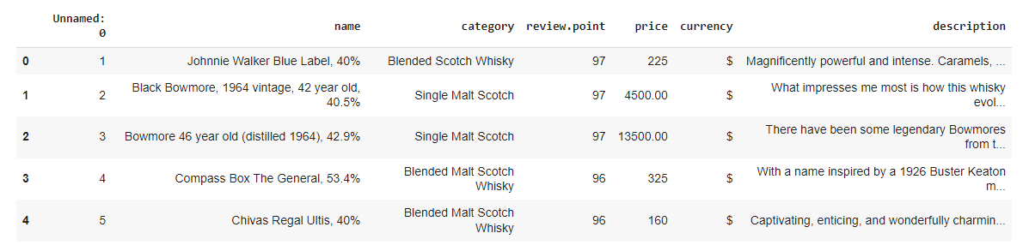

Significant data cleaning was required for the "2.2k review" dataset.
Before
Remove unneeded columns
Separate strings into unique columns of brand and % alcohol
Convert object types to integers (review point, price, % alcohol)
Ensure whisky brand names are the same for joining
Identify and correct missing/erroneous values
Sc ub

Slide 5
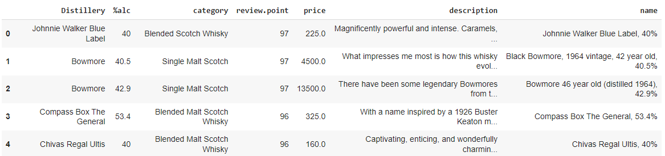
Significant data cleaning was required for the "2.2k review" dataset.
Before
Remove unneeded columns
Separate strings into unique columns of brand and % alcohol
Convert object types to integers (review point, price, % alcohol)
Ensure whisky brand names are the same for joining
Identify and correct missing/erroneous values
After
Sc ub

Slide 6
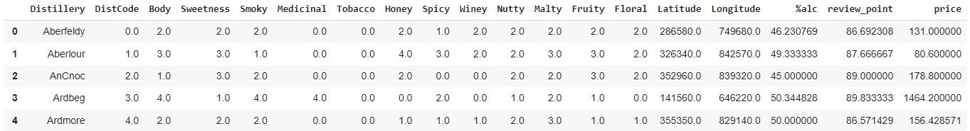
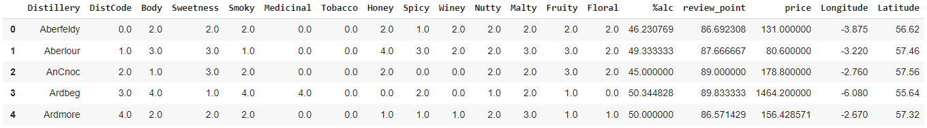
This working data frame has over 1,500 observations for all 86 distilleries present in the "Scotch Whisky" dataset.
Data was collapsed by average for each distillery
Additional data cleaning required for the latitude and longitude values
Sc ub

Slide 7
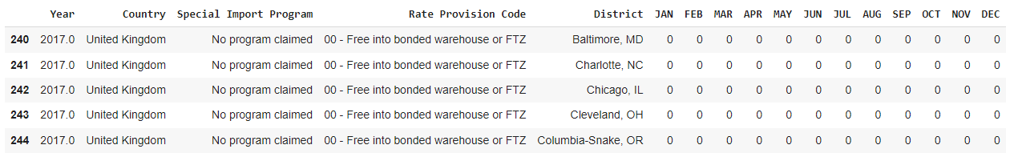
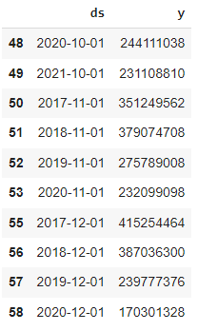
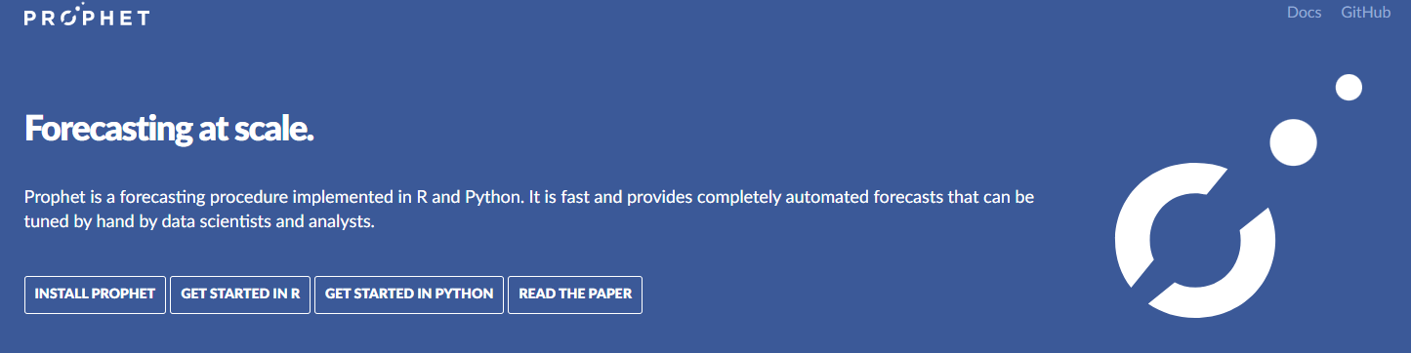
The US Trade and Tariff dataset required del, as.type(int) & as.type(float), groupby.sum and melt in order to use in Prophet.
Before
After
Sc ub

Slide 8
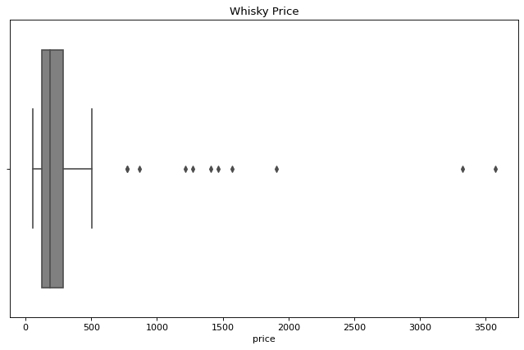
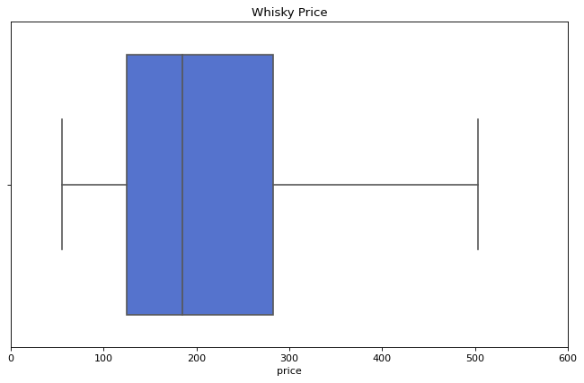

Distribution of Scotch Whisky Prices (USD)
All whisky: Without outliers:
Total Whisky Stats:
Median Price: 185.03 Std: 566.31
Min: 55.25 Max: 3,571.95
Mean Price: 355.09 IQR: 158.28
Expl re

Slide 9
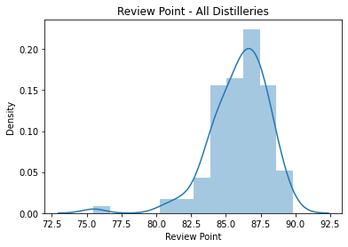
Distribution of Scotch Whisky Review Point
Median Review Point: 86.3
Mean Review Point: 86
Min: 75.5
IQR: 2.7
Std: 2.1
Max: 89.8
Expl re

Slide 10
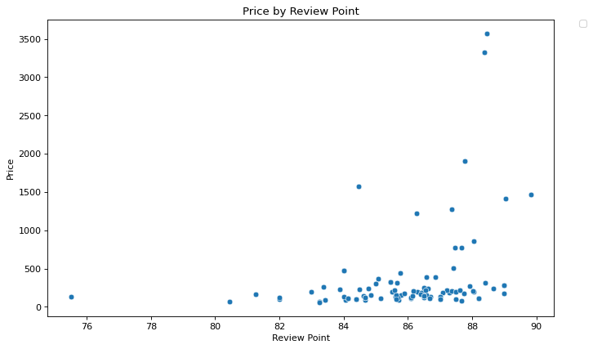
A higher rating does not necessarily mean more expensive scotch.
Expl re

Slide 11
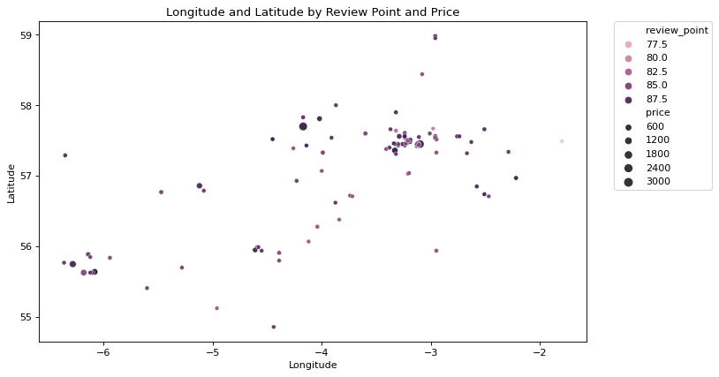
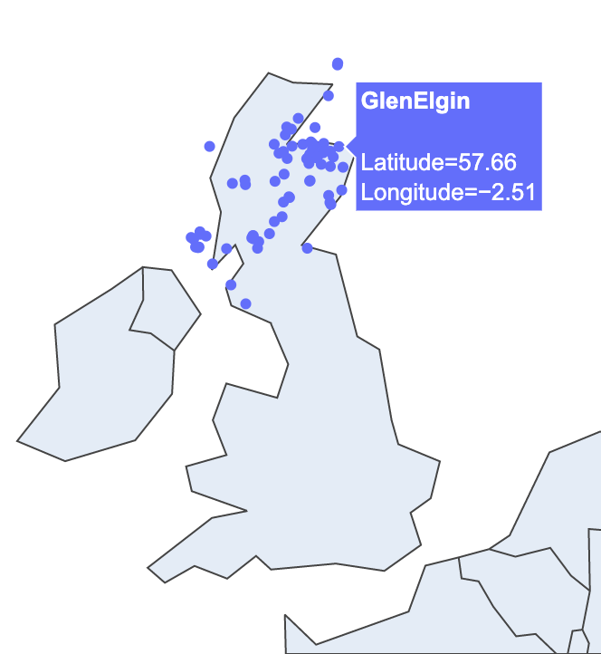
Have a wee dram in Speyside
Expl re

Slide 12
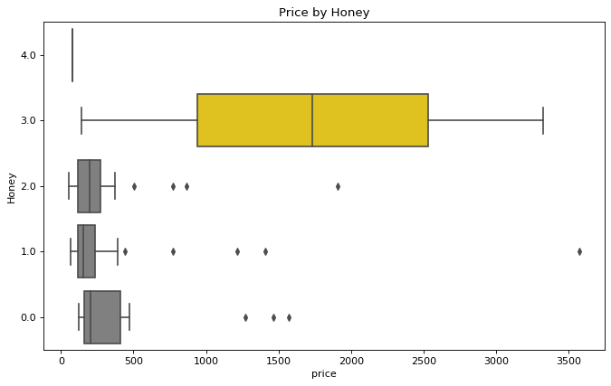
Consumers are willing to pay more money when they can taste notes of honey.
Expl re

Slide 13
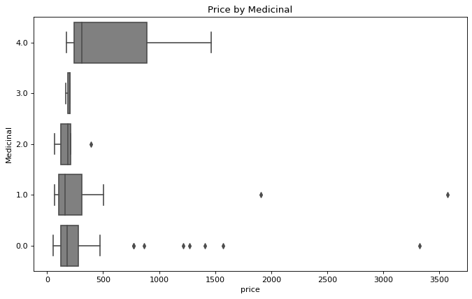
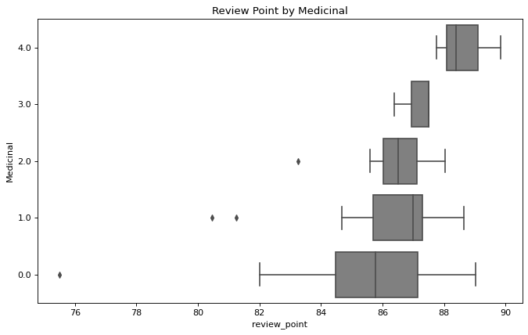
Distributions of Medicinal by Price and Review Point
Expl re

Slide 14
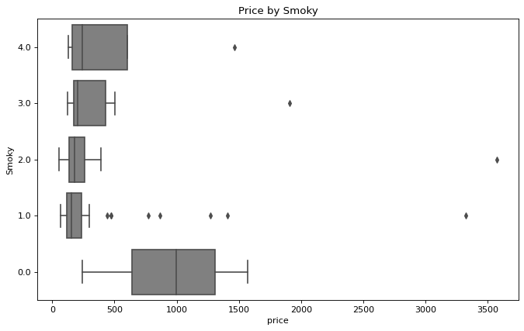
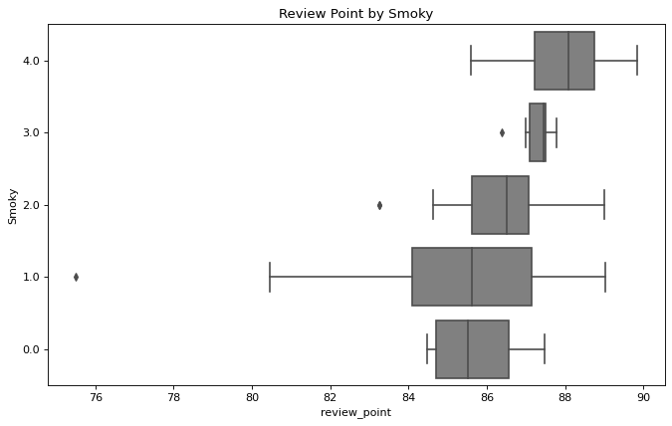
Is smokier scotch pricier? Rated higher?
Expl re

Slide 15
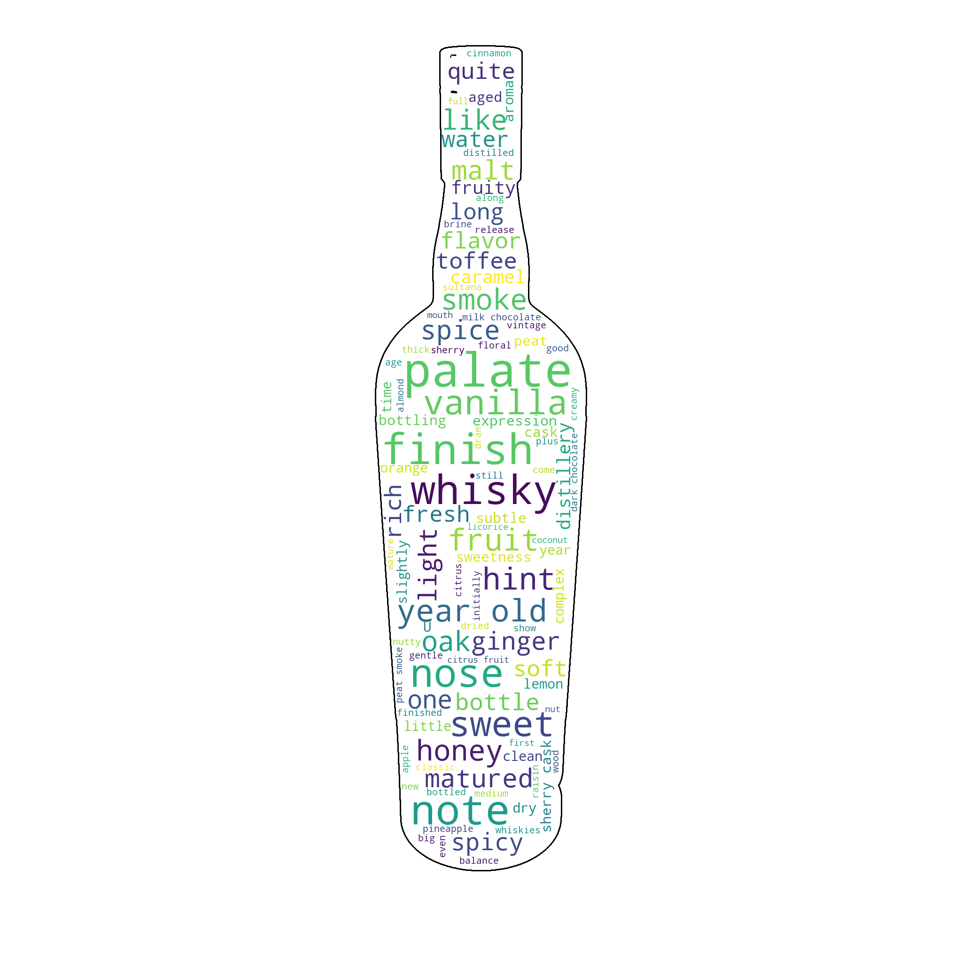
What do customer reviews tell us?
Bigram frequencies were calculated with and without the Pointwise Mutual Information (PMI) function.
PMI measures the ability for each word to be on their own and probability that each of these words will be next to each other.
The top PMI has a probability of over 14% and the top 5 are all above 13%.
(('rhum', 'agricole'), 14.077886645352248)
(('bog', 'myrtle'), 13.8554942240158)
The reviews were made up of 73.8% positive reviews, 1.2% negative reviews, and 25% neutral reviews.
Expl re

Slide 16
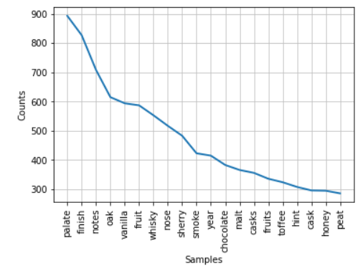
What do customer reviews tell us?
Positive reviews focused on flavor.
Example: Magnificently powerful and intense. Developing vanilla and a hint of over-ripe bananas. Finally, burnt sugar and caramel.
Negative reviews focused on cost.
However, some reviews could fall into any of the 3 categories
Example: This has a significant proportion of sherry wood and it marks a real step up from its younger stablemates.
Neutral reviews focused on how the whisky was created vs taste.
Example: After hogshead maturation the whisky ultimately underwent a period of finishing in an ex-sherry cask prior to bottling.
Top 20 Scotch Noun Tokens
Expl re

Slide 17
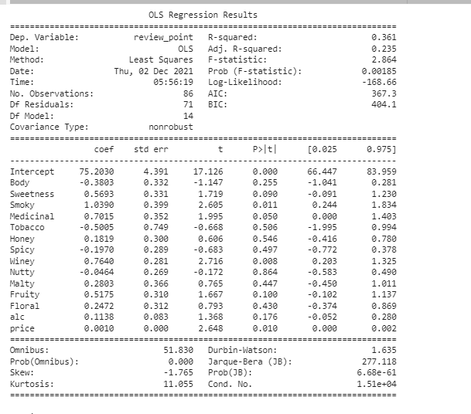
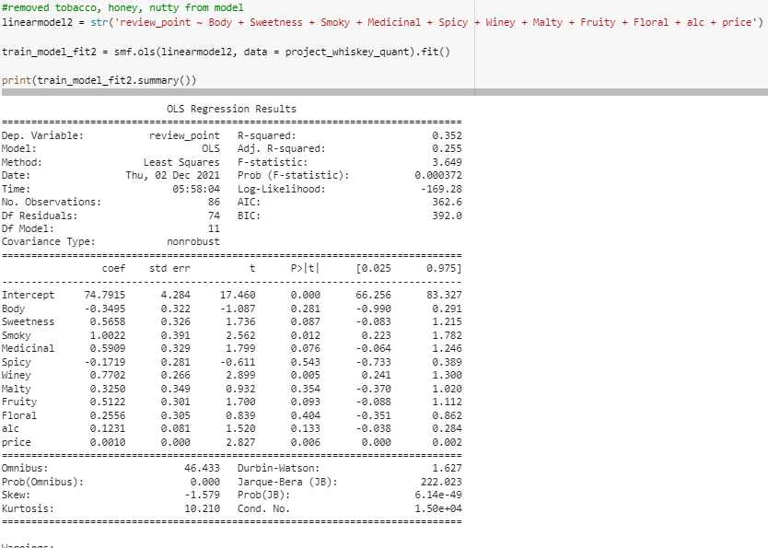
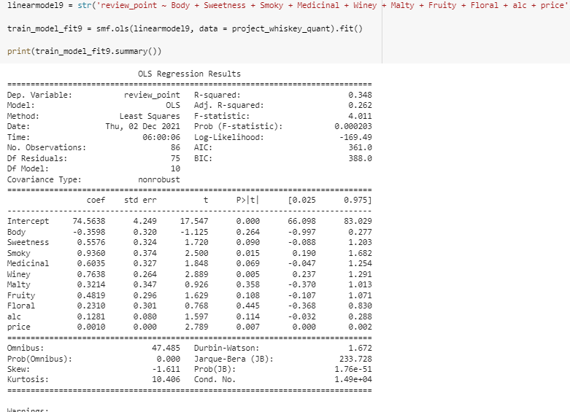

Ratings can't be predicted based on alcohol %, taste, or price.
Mode

Slide 18
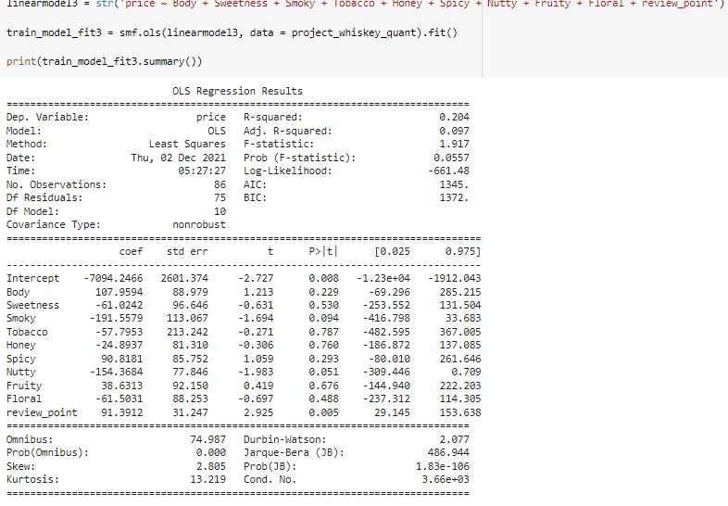
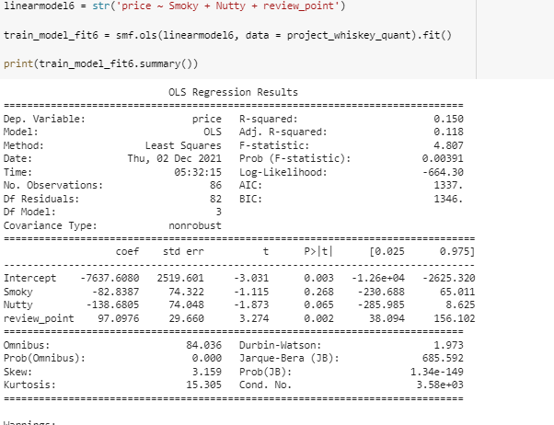
Cost can't be predicted based on attribute scores of whisky.
Mode

Slide 19
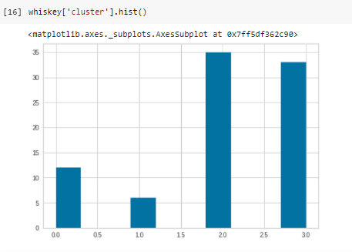
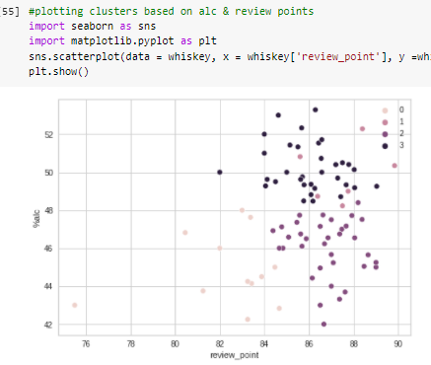
Consumer reviews tell us how the clusters are composed.
Mode

Slide 20
If customers are looking for spicy, we recommend cluster 1.
High in sweetness, malty, floral, 46.9% alcohol average :
Aberfeldy, Auchentoshan, Cardhu, Glenlivet, Old Pulteney, Tomatin
Highest in body, smoky, medicinal, spicy, 49.9% alcohol average :
Ardbeg, Caol Ila, Clynelish, Lagavulin, Laphroaig, Talisker
High in sweetness, body, fruity, floral, 50.3% alcohol average :
Aberlour, Ardmore, Bowmore, Glenallachie, Mannochmore, Strathmill, Tobermory
High in sweetness, fruity, malty, body, 44.0% alcohol average :
Dalmore, Glenfiddish, Knockando, Royal Lochnagar, Romintoul, Tullibardine
Cluster 0
Cluster 1
Cluster 2
Cluster 3
Mode

Slide 21
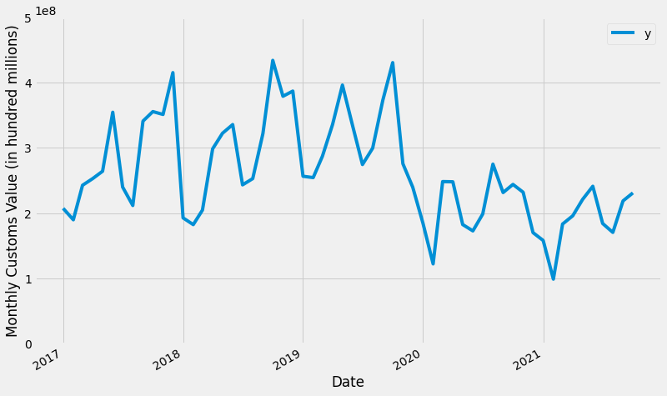
COVID-19 greatly affected whisky imports from the UK to the US.
US and UK shutdowns,
Increased restrictions
Mode

Slide 22
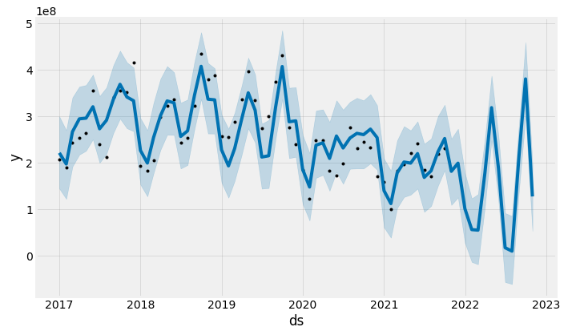
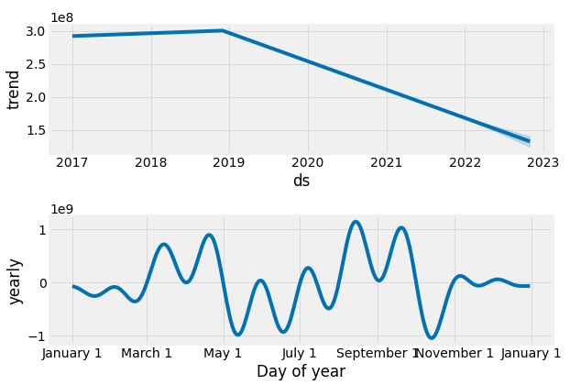
Prophet forecasts continued decline in whisky imports from the UK to the US.
Mode

Slide 23

Key Takeaways
A higher rating does not necessarily equate to a more expensive scotch.
Distinguishable flavors (such as honey) lead to better reviews.
Ratings can't be predicted based on the alcohol percentage, taste profile, or price.
K-Means clusters can be used to help consumers choose a whisky based on flavor profiles
UK to US imports projected to decrease over the next few years – stock up consumers!
Nterpret

